Slide 1

Battle of the Neighbourhoods – Finding the right move in London
Jonathan Challenger

Slide 2
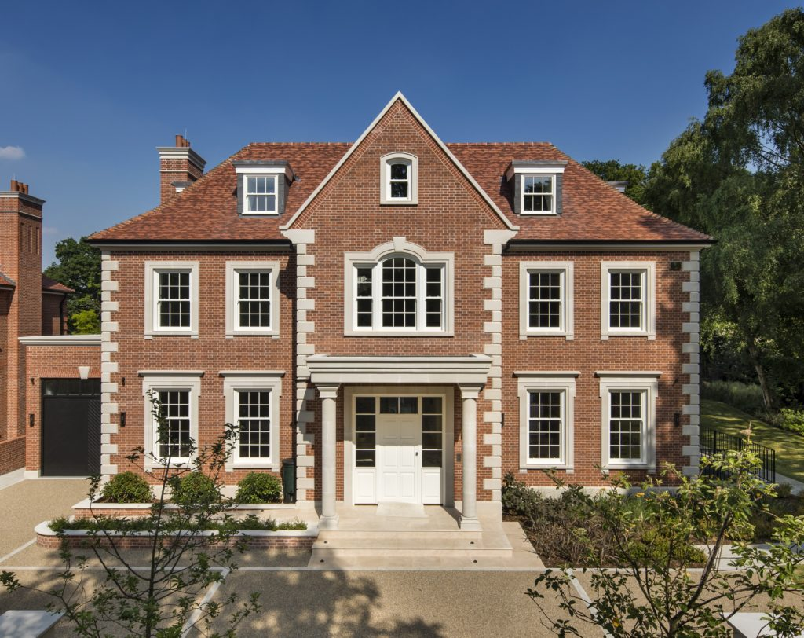
Introduction
Approximately 400,000 people move to London each year. Therefore it would be advantageous to make each move as efficient as possible for both the mover and the real estate agent.
If areas in London can be clustered based on nearby venues this can help streamline the moving process by fully informing the mover.
It is also an interest for real estate agents as they can invest more time into movers who are more informed and therefore more likely to complete the move.

Slide 3
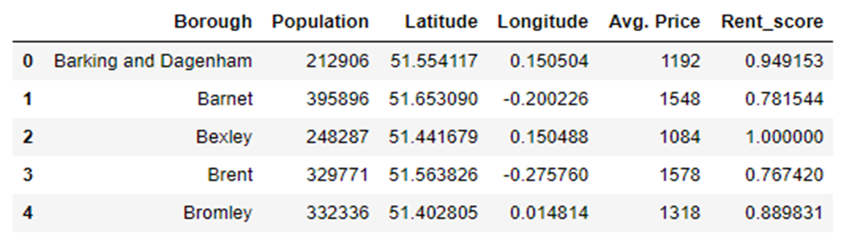
Data
London borough data including longitudes and latitudes was scraped from https://en.wikipedia.org/wiki/List_of_London_boroughs
Average rent pricing for each borough was taken from a dataset from https://data.london.gov.uk/dataset/average-private-rents-borough
The data was then cleaned dropping unnecessary features and formatting each feature desirably.
The cleaned data consisted of 6 features.

Slide 4
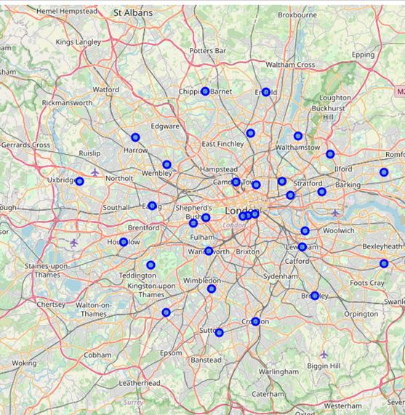
Methodology
All London boroughs were plotted onto a map of London using the Folium library.
Foursquare venue data was extracted for each borough in London.

Slide 5
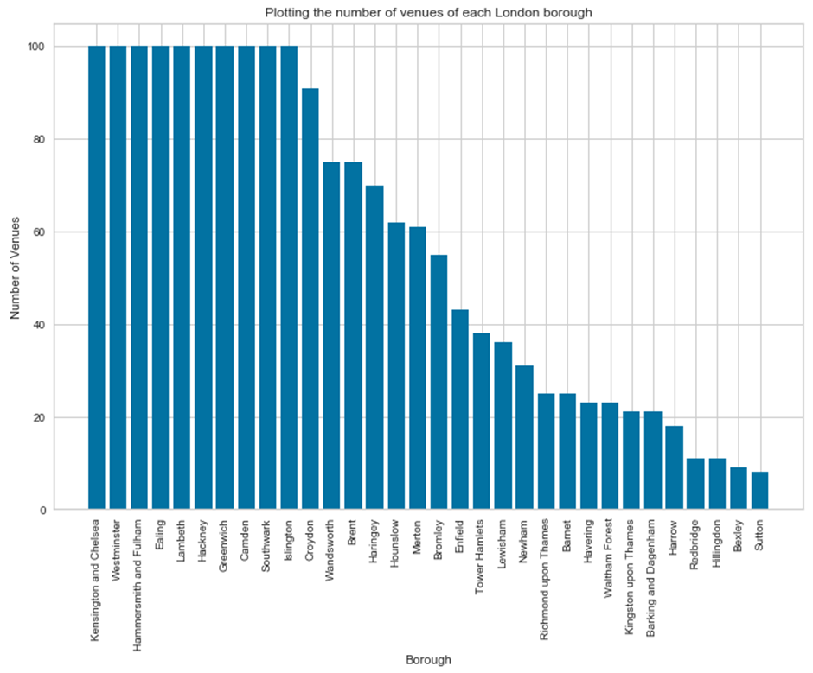
Methodology
Graph showing the number of venues for each borough
Only boroughs with 10 or more nearby venues were used for the clustering analysis.

Slide 6
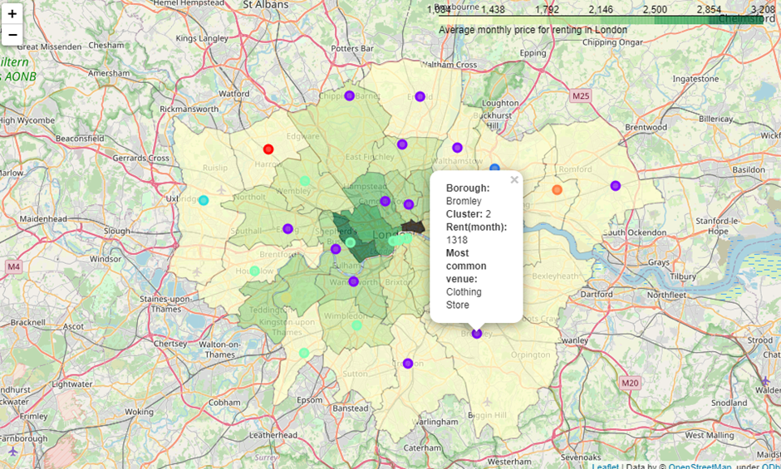
Analysis
K-means clustering was used in the current project as we are aiming to cluster unlabelled data.
This would cluster each London borough based on the similarity of its nearby venues
A map of London with clustered boroughs and price information was created.

Slide 7
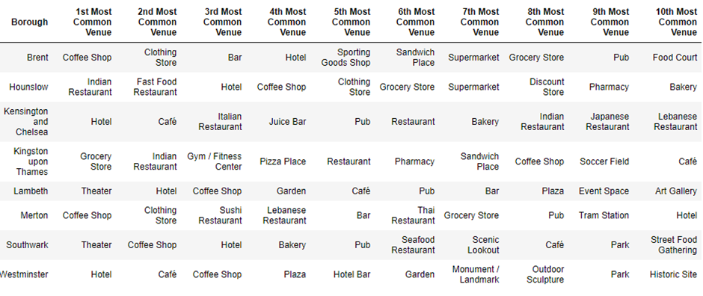
Results and Discussion
Each cluster was then examined individually to determine the most common venues for each cluster label.
This is an example of cluster 5 where we can see that the most common venues in this cluster include hotels, coffee shops, theatres and various restaurants.

Slide 8
Results and Discussion
This analysis allowed us to discover venue information for each borough in London which can help to aid a mover in making their decision as nearby amenities are important when moving home.
One limitation of the analysis is the use of boroughs with a limit of 100 venues. This could be too restrictive in the number of venues in some boroughs. Expanding this limit to include more venues could lead to more accurate clustering.
If the limitations are acknowledged in future research this analysis has potential to be hugely useful for movers and real estate agents.

Slide 9

Conclusion
This project has focused on helping people who want to move to London by clustering boroughs in London to help movers make a fully informed decision. This analysis and system can be generalised and used for any place in the world. This project has exciting real life applications and huge potential in the future with the limitations being addressed.

